Slide 1

MCSE Guide to Microsoft Windows 7
Chapter 5
Managing File Systems

Slide 2
Objectives
Understand file system features and limits in Windows 7
Understand file system management tasks
Understand file and folder attributes used in the FAT and NTFS file systems
Understand file and folder permissions, permission scope and inheritance, plus the impact of ownership and moving or copying content
Understand how to use previous versions of files

Slide 3
Supported File Systems
File system
  Allows OS to store and organize files on a hard disk
Windows 7 supports four file systems
  File Allocation Table
  NT File System
  Universal Disk Format
  CDFS File System
  Extended File Allocation Table

Slide 4
File Allocation Table
File Allocation Table (FAT)
  Earliest file system used for hard disks by the MS-DOS operating system
Versions of FAT
  FAT12
  FAT16
  FAT32

Slide 5
File Allocation Table (cont'd.)
FAT limitations
  Limited fault tolerance
  Inefficient storage
  Limited security
FAT benefits
  Supported by many legacy operating systems
  Simple technology
  Adequate when file and folder requirements are simple
  Suitable for removable media

Slide 6
New Technology File System
New Technology File System (NTFS)
  First introduced with Windows NT
NTFS partitions are theoretically limited to 256 Terabytes
Each operating system that supports NTFS is designed for a specific version of NTFS
NTFS stores files very similar to FAT
  Data is secure, reliably managed, and allowed to grow

Slide 7
New Technology File System (cont'd.)
NTFS advantages
  Log file and checkpoint consistency checks
  Automatic bad cluster management
  Transactional NTFS
  File names stored in Unicode and 8.3 DOS format
  Alternate data streams
  Encrypted File System (EFS)
  File and folder permissions
  Compression
  Disk quotas
  Shrinkable/extendable partitions and volumes
  Mount points
  Sparse files

Slide 8
New Technology File System (cont'd.)
Log File and Checkpoint Consistency Checks
  Information about files and folders stored on the disk is kept in a special file
    Called the Master File Table (MFT)
  System files are hidden from general browsing
  NTFS system files are protected by a transactional file system
  Changes made to the NTFS system files can be rolled back to a known good state

Slide 9
New Technology File System (cont'd.)
Automatic Bad Cluster Management
  Bad Cluster File keeps a record of all the clusters that are considered unusable
  If the bad cluster is currently used by a file or folder
    OS will try to move that data to a different cluster

Slide 10
New Technology File System (cont'd.)
Transactional NTFS
  Similar to the transactional system used to protect NTFS system files
  Utilize change logs and checkpoints to validate that updates have successfully completed
File Names Stored in Unicode and 8.3 DOS Format
  Windows 7 can use Unicode characters in the filename
  Each file has two names assigned to it
    Long filename
    8.3 filename compatible with MS-DOS

Slide 11
New Technology File System (cont'd.)
Alternate Data Streams
  NTFS file system can have multiple streams of data associated with it
  Applications can create additional named streams and link them to the file
Encrypted File System
  NTFS files can be encrypted to protect the information from unauthorized users
  Valuable form of protection for local file access
  Digital encryption keys from each user are implemented to encrypt and decrypt the file

Slide 12
New Technology File System (cont'd.)
File and Folder Permissions
  Each file and folder on an NTFS file system has its own list of permissions
    Determine the actions that users or groups are allowed to perform with that item
  List of permissions is known as the Access Control List (ACL)
  ACL permissions are stored in NTFS system files hidden on the partition itself
Compression
  Can compress files to save space on NTFS volumes

Slide 13
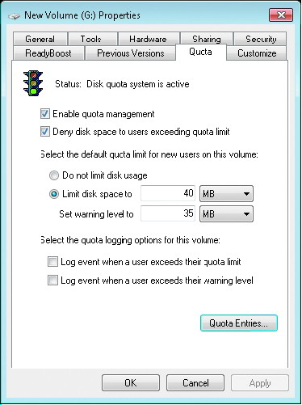
New Technology File System (cont'd.)
Disk Quotas
  Amount of disk space used by a user
  By default, disk quota limits are not enabled for NTFS partitions
  Set using the Disk Management console
Shrinkable/Extendable Partitions and Volumes
  File system can adapt when the partition or volume is resized

Slide 14
New Technology File System (cont'd.)
Volume Mount Points
  Allow an empty folder in an NTFS-formatted file system to point to another partition or volume in the local computer
  Created with the Disk Management console
  Different mount points can point to the same target partition or volume
Symbolic Links
  Introduced with Windows Vista
  Point to a file or folder located somewhere other than that folder

Slide 15
New Technology File System (cont'd.)
Sparse Files
  Large portions of a sparse file contain bytes with the value of zero
  Contain nonzero data and a list that identifies where ranges of empty data occur between the nonzero data
  Space occupied in the disk corresponds only to the nonzero part

Slide 16
Universal Disk Format
Universal Disk Format (UDF)
  File system defined by the Optical Storage Technology Association (OSTA)
  OSTA was created to promote the use of recordable optical technologies and products
  Developed as a standard to allow file interchange between different operating systems
  Ideal for storing files on portable CD-ROM and DVD media
UDF is an evolving specification and several versions are defined by the OSTA

Slide 17
CDFS File System
CD-ROM File System (CDFS)
  Legacy file system for read-only CD-ROM media
Windows 7 supports CDFS for compatibility with older CD-ROM media
CDFS standard closely follows the ISO 9660 standard
UDF is current preferred file system for CD media

Slide 18
Extended File Allocation Table
Extended File Allocation Table (exFAT)
  New file system used by the manufacturer for large portable memory devices
Recommended for volume sizes of 512 TB or less
  Can theoretically support a volume size equivalent to the sum total of a billion blocks sized at 64 TB each
Microsoft introduced native support for exFAT with Windows Vista Service Pack 1

Slide 19
File System Tasks
Common file system changes
  Changing the assigned drive letter
  Converting the installed file system

Slide 20
Changing Drive Letters
Drive letters
  Used by applications and users as a quick reference to locate files
Can change the drive letter, or assign a new one, to a partition or volume
  Using the Disk Management console
A single drive letter can only be assigned to one partition or volume
Can remove drive letters from a partition or volume

Slide 21
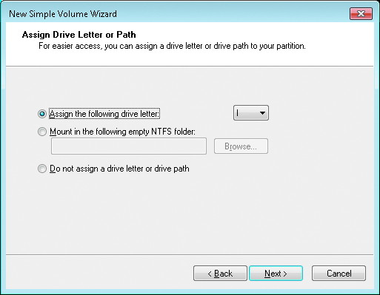
Assigning Drive Letters

Slide 22
Converting File Systems
Steps to convert NTFS to FAT
  Back up the data on the partition
  Reformat the partition with FAT or FAT32
  Restore the data originally backed up from the NTFS partition
Steps to convert FAT to NTFS
  Back up the data on the partition
  Ensure free space remains on the partition
  Convert partition using convert command-line utility
Convert command-line utility has the syntax of convert drive_id /FS:NTFS
Converting a partition requires that the convert utility runs with full Administrative access
  To the local computer

Slide 23
File and Folder Attributes
FAT and NTFS file systems use attributes
  To describe general information about a file or folder

Slide 24
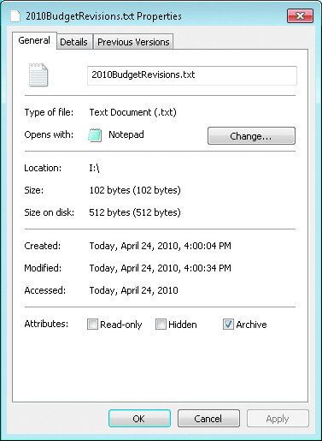
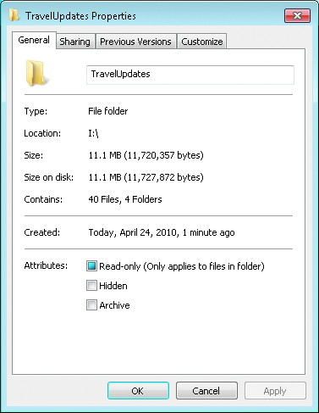
File and Folder Attributes (cont'd.)
Details on the General tab for a file on a FAT file system
Details on the General tab for a folder on a FAT file system

Slide 25
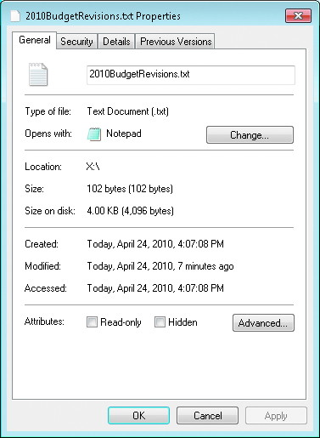
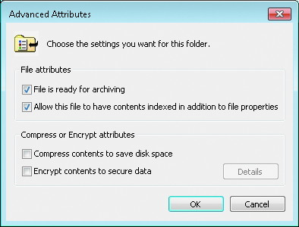
File and Folder Attributes (cont'd.)
Details for a file on an NTFS file system
Advanced attributes for a file on an NTFS file system

Slide 26
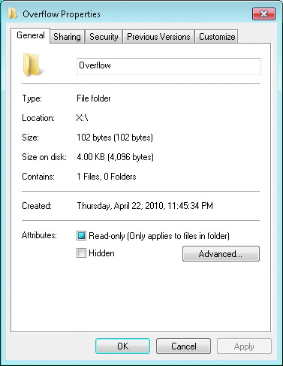
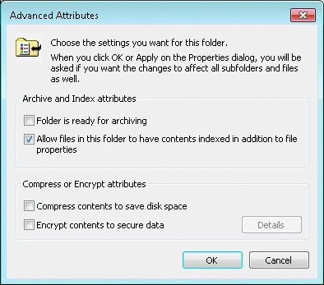
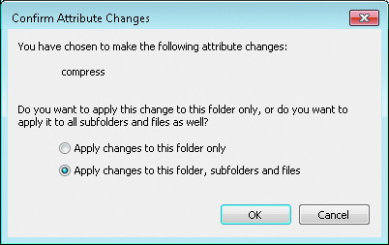
File and Folder Attributes (cont'd.)
Details for a folder on an NTFS file system
Advanced attributes for a folder on an NTFS file system

Slide 27
Attribute Flags
Attribute flags
  Control some aspects of how the operating system interacts with the object
Read Only
  Flag will block changes to the contents of a file
  Flag is used to indicate that the folder is a system folder and should be treated differently
Archive
  Set by OS when a file or folder changes

Slide 28
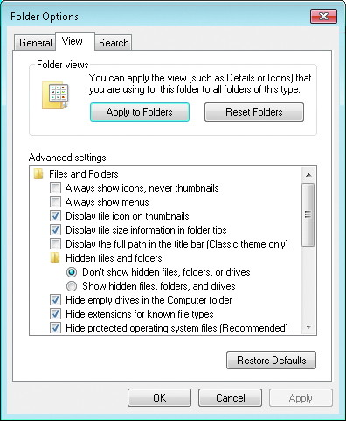
Attribute Flags (cont'd.)

Slide 29
Attribute Flags (cont'd.)
Archive (cont'd.)
  Indicates that the contents have changed since the last time the file was backed up
Hidden
  Set by user or OS to hide folders and files from user
System
  Set by OS for specific folders and files

Slide 30
Attribute Flags (cont'd.)
Compress
  Only supported on volumes and partitions formatted with NTFS
  When a file is moved from its current location to a new location in the same NTFS partition
    Attributes do not change
  When copying compressed files
    Compress attribute on the file becomes the same as the target folder’s compress attribute setting

Slide 31
Attribute Flags (cont'd.)
Encrypt
  Only supported on volumes and partitions formatted with NTFS
  Folder or file that is set to be encrypted cannot be compressed
  Folder that is set as encrypted is not encrypted itself
  Only users with valid digital security keys can decrypt and access an encrypted file’s contents
  Encrypted file will remain encrypted unless:
    Encrypt attribute is disabled
    File is saved to a volume that does not support encrypt

Slide 32
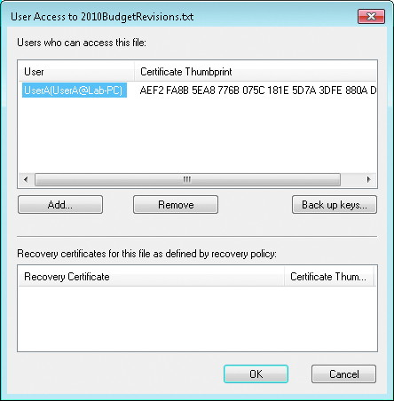
File Certificate

Slide 33
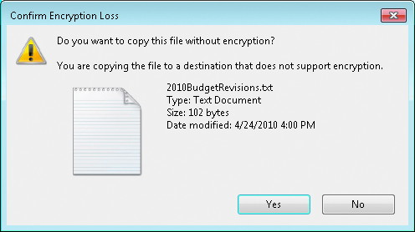
Warning of Loss of Encription

Slide 34
File and Folder Permissions
Access Control List (ACL)
  Collection of Access Control Entries (ACE)
    Identify a specific security identifier (that is, who) can perform a given action (that is, what) to a file or folder
  Used to specify what a user or group is allowed to do with the file or folder
ACLs are supported by Windows 7 for the NTFS file system

Slide 35
Default Folder Permissions
First level of folder in an NTFS partition is root folder
Default permissions for the root folder
  Members of the Administrators group have full control
  OS has full control
  Members of Users group can read and execute programs
  Authenticated users can create folders in this folder
  Authenticated users can create files and write data in subfolders only

Slide 36
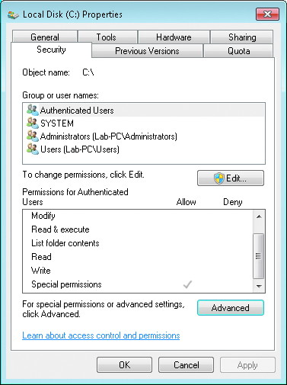
Default Folder Permissions (cont'd.)

Slide 37
Default Folder Permissions (cont'd.)
Default permissions for C: subfolders
  Members of Administrators group have full control
  OS has full control
  Members of Users group can read and execute programs
  Authenticated users can create, modify, and delete files and folders
    In this folder and its subfolders
Additional folders and files inherit permissions from the parent
Inheritance allows a permission setting to propagate to lower subfolders
NTFS permissions are assigned using two formats
  NTFS standard permissions
  Individual NTFS permissions

Slide 38
NTFS Standard Permissions
Collection of predetermined individual NTFS permissions
Write
  Used for folders, allows new files and folders to be created in the current folder
  Used for files, allows file data to be rewritten
Read
  Allows files and folder data, attributes, ownership, and security to be viewed

Slide 39
NTFS Standard Permissions (cont'd.)
List Folder Contents
  Only applies to folders
  Allows files and folders contained in a folder to be listed
Read & Execute
  Used for folders, allows read access to files and folders below this point
  Used for files, allows read access to the file’s information
    If it is an executable file, the user is allowed to run it

Slide 40
NTFS Standard Permissions (cont'd.)
Modify
  Allows the same actions as Write and Read & Execute permissions combined
Full Control
  Allows the same actions as Modify plus the ability to change permissions
  Also allows a user to take ownership
Special
  Special permissions are the individual permissions that can be assigned

Slide 41
Individual NTFS Permissions
Fine-tune access and control for files and folders
Only visible when editing a permission entry in the advanced security view

Slide 42
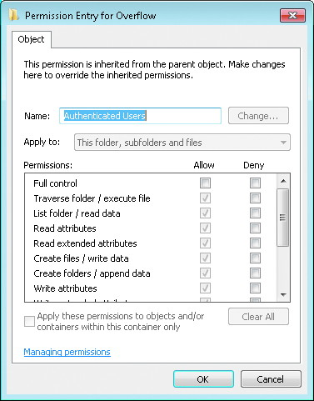
Individual NTFS Permissions (cont'd.)

Slide 43
Permission Scope
Determines what other objects are impacted by the assigned permission
For files, the scope is limited to this object only
Scope for folders include:
  This folder only
  This folder, subfolders, and files
  This folder and subfolders
  This folder and files
  Subfolders and files only
  Subfolders only
  Files only

Slide 44
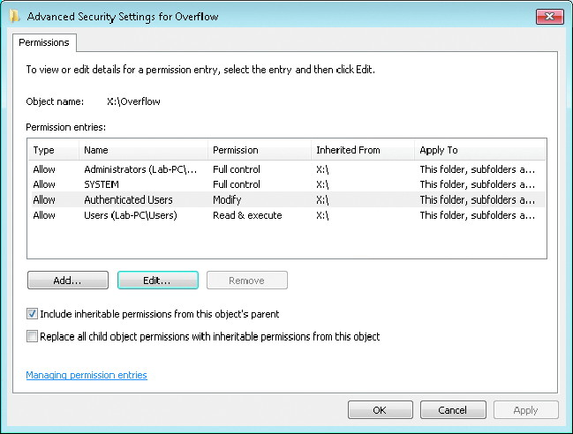
Permission Scope (cont'd.)

Slide 45
Permission Inheritance
NTFS permissions for folders apply to the first folder on which they are used
  Permission propagates to all folders below that point
Inheritance can be blocked
  Once blocked, the object needs new permissions assigned to it
Any file or folder can have additional permissions assigned directly to the object
  That combine with the inherited permissions

Slide 46
Effective Permissions
Many items have an impact on calculating permissions
  Permissions can be inherited or directly assigned
  Each permission has a scope that determines what range of objects it applies to
  Permissions can be allowed or denied
  Permissions can be applied to groups, and any member of that group receives those permissions
  Users can be members in multiple groups that have different permissions to the same object
  Owners of a file or folder have full control of the object
Effective Permissions tab
  Helps to simplify the analysis of assigned permissions

Slide 47
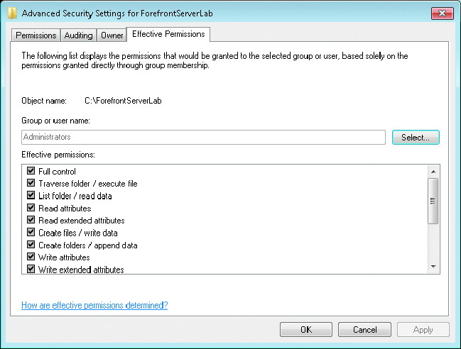
Effective Permissions (cont'd.)

Slide 48
Ownership
Each NTFS file or folder has an owner
Owner of a file or folder always has the ability to assign permissions to that file or folder
Members of the Administrator group
  Have the right, by default, to assign or take ownership of a file or folder
Users with the Full control standard permission or the individual NTFS permission Take ownership
  Can also assume ownership of a file

Slide 49
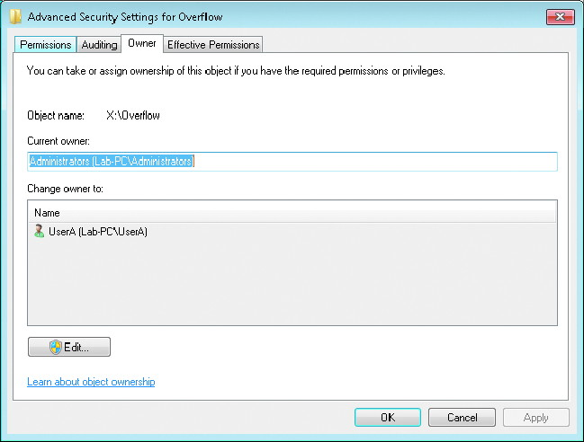
Ownership (cont'd.)

Slide 50
Permission Changes When Content Is Copied or Moved
Copy operations always create new versions of the content that is being copied
  New versions will inherit the permission settings of the target location
Move operations affect permissions differently
  Depending on the destination location relative to the source location
  Source and target locations on the same volume, no changes
  Source and target locations on different volumes, just like a copy operation

Slide 51
Permission Strategy Considerations
Poorly designed permission strategy can quickly lead to problems
Best practices
  Folder structure should be designed so that permissions can easily flow down
  Folder structure should have a specific permission strategy before users are allowed to store files in it
  Specific permissions can be applied to a file or folder for a given user or group of users
  Exceptions to permissions can be made
  All folder permissions strategies should be tested

Slide 52
Previous Versions
Windows 7 includes a new Previous Versions tab
Use this tab to restore a previous version of a file after it has been modified or deleted
Previous versions of a file on the local computer are generated by backup or shadow copies
Shadow copies
  System in which the computer takes a snapshot of files at a specific point in time
    And then tracks changes to those files

Slide 53
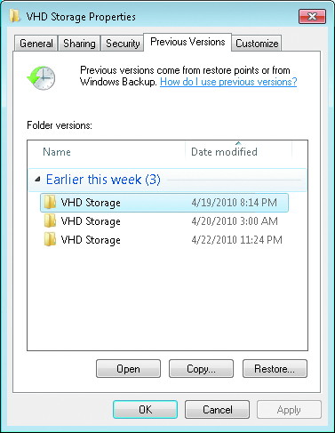
Previous Versions (cont'd.)

Slide 54
Summary
Primary file systems used to format bulk storage are FAT, NTFS, and UDF
Users and applications can use drive letters or mount points to access partitions and volumes
NTFS allows special support for larger partitions, alternate data streams, sparse files, file names with special characters, and transactional reliability
NTFS allows the use of symbolic links
Files stored in FAT and NTFS partitions use attributes to control and limit file access

Slide 55
Summary (cont'd.)
Given a NTFS formatted source location, a copy operation will create content in a destination location
NTFS files and folders are protected by standard permissions
Permissions strategies should be carefully considered and documented before they are implemented
Previous Versions tab can be used to restore files from backup or shadow copies

